Slide 1
Inventory Management System
By David Holloway

Slide 2
Project Goal
Goal of application was to create an interactive inventory management application
Use relational database
Which could then be accessed and manipulated by users

Slide 3
Spec
The project spec included:
building an application that an end user can interact with via a CLI (Command Line Interface)
Having CRUD functionality
Having a relational database with no many to many dependencies

Slide 4
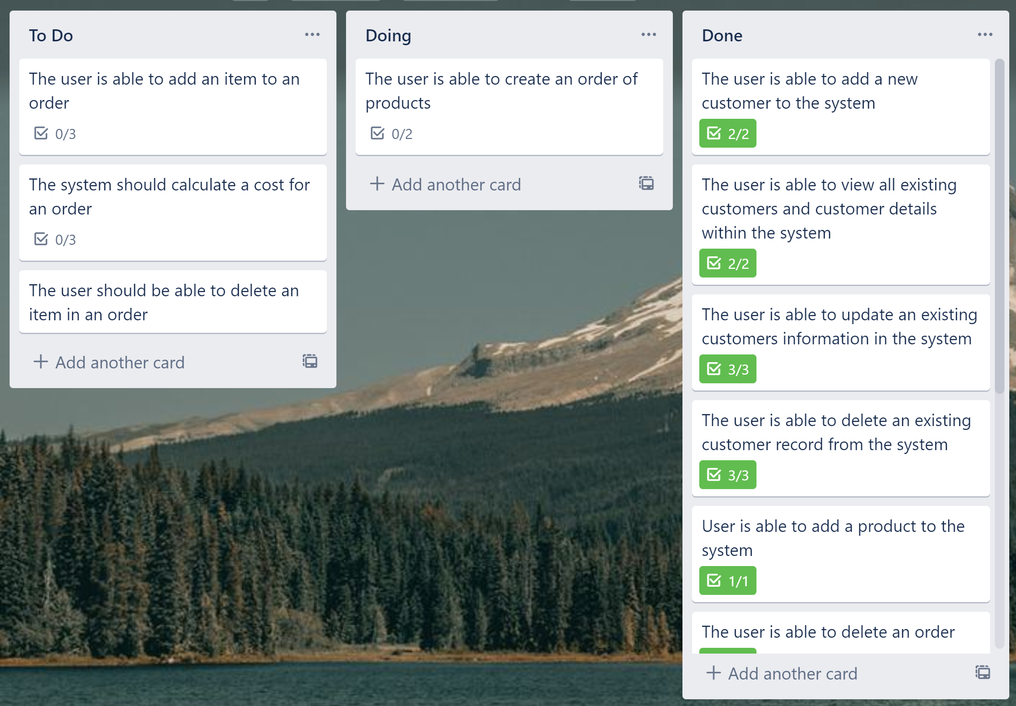
Initial Plans
Kanban board created on Trello

Slide 5
Scope of Project
- Create Kanban Board
- Create A relational database
- Create unit tests and integration tests
- Have a version control repository

Slide 6
Technologies Used
Eclipse IDE (Java)
mySQL Workbench (create sql database)
GCP
Junit testing

Slide 7
Unused Technologies
Mockito
Unable to incorporate into tests due to lack of understanding

Slide 8
Consultant Journey
What have I learned ?
- Developed a greater understanding of the Agile approach to project management
Effectiveness of sprints
Consolidate java knowledge
Consolidate on SOLID principles
Made inroads on testing knowledge – room for improvement

Slide 9
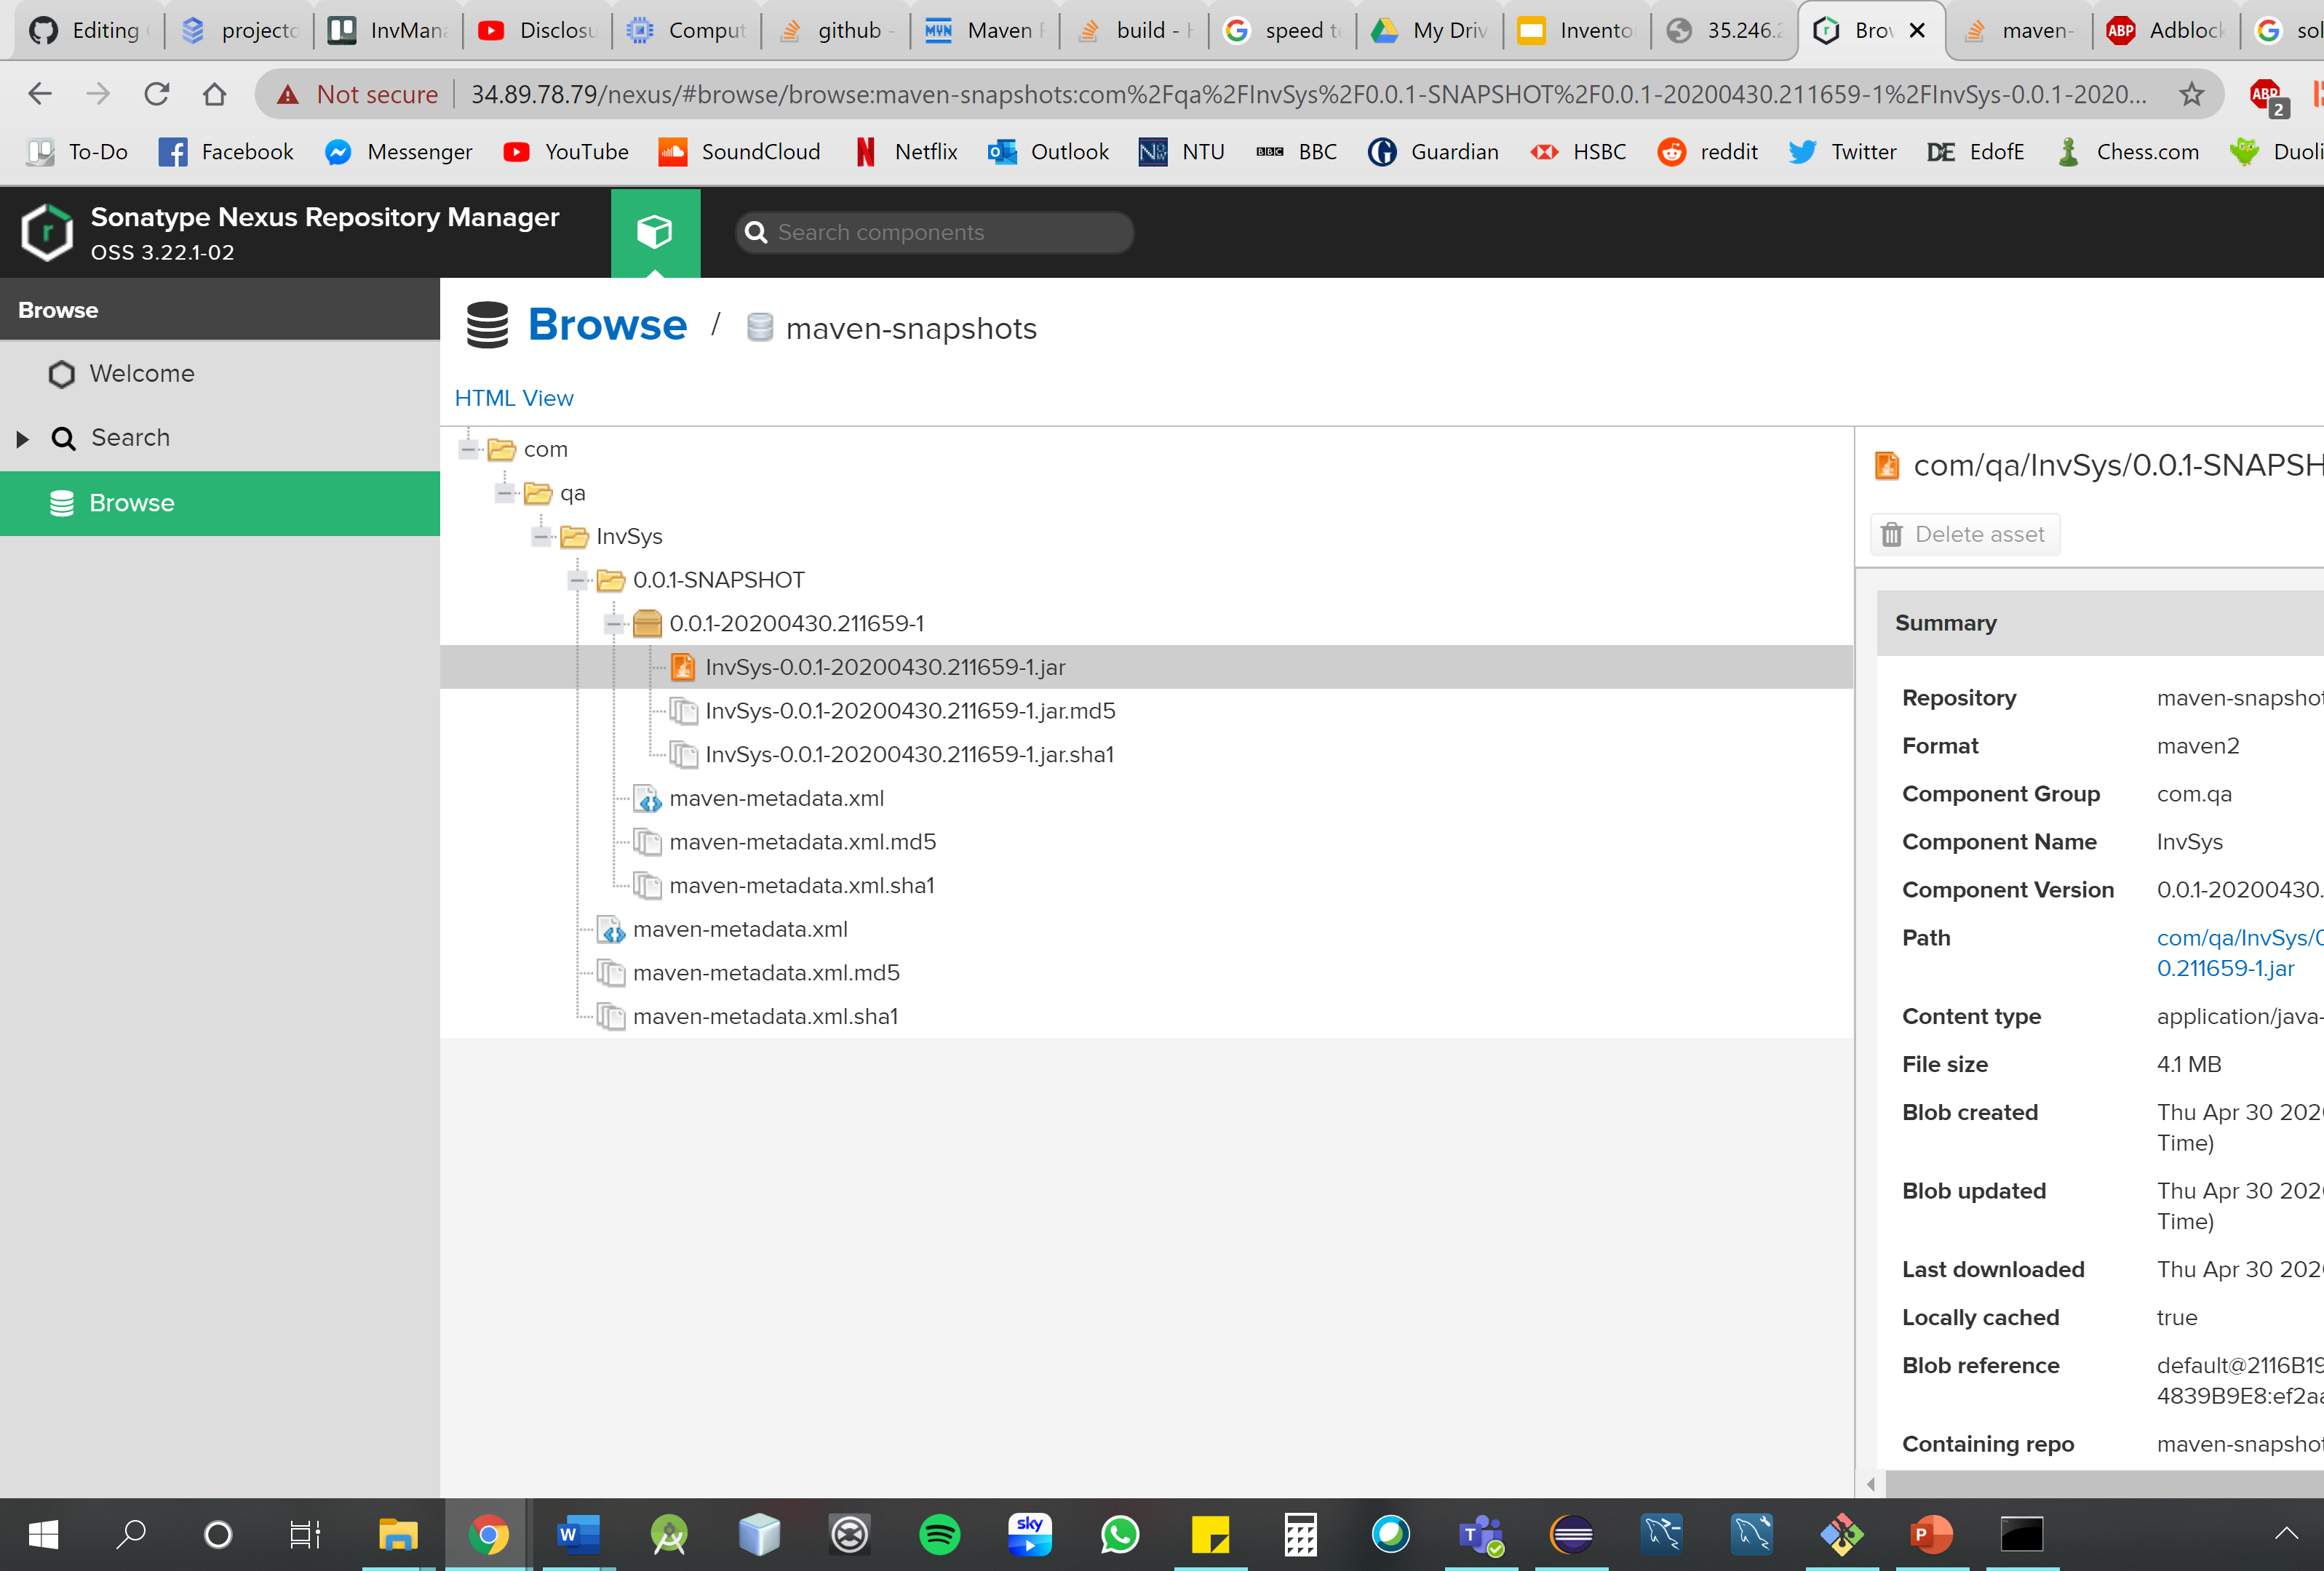
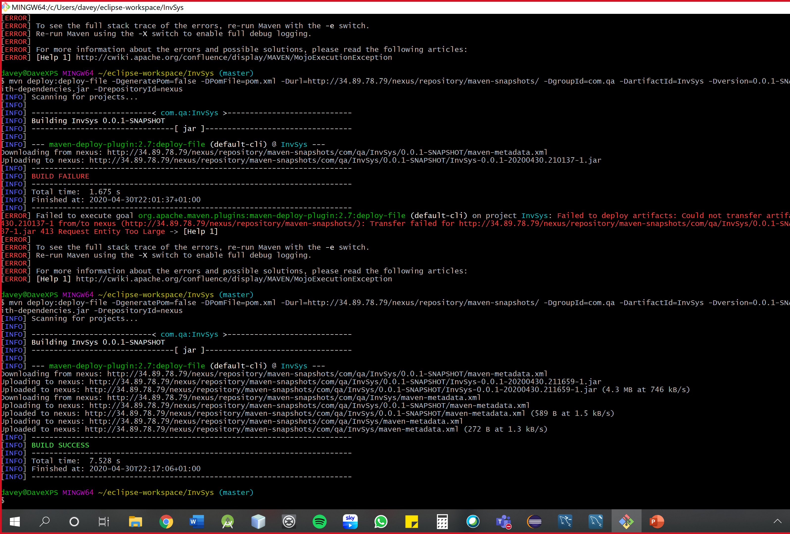
Nexus

Slide 10
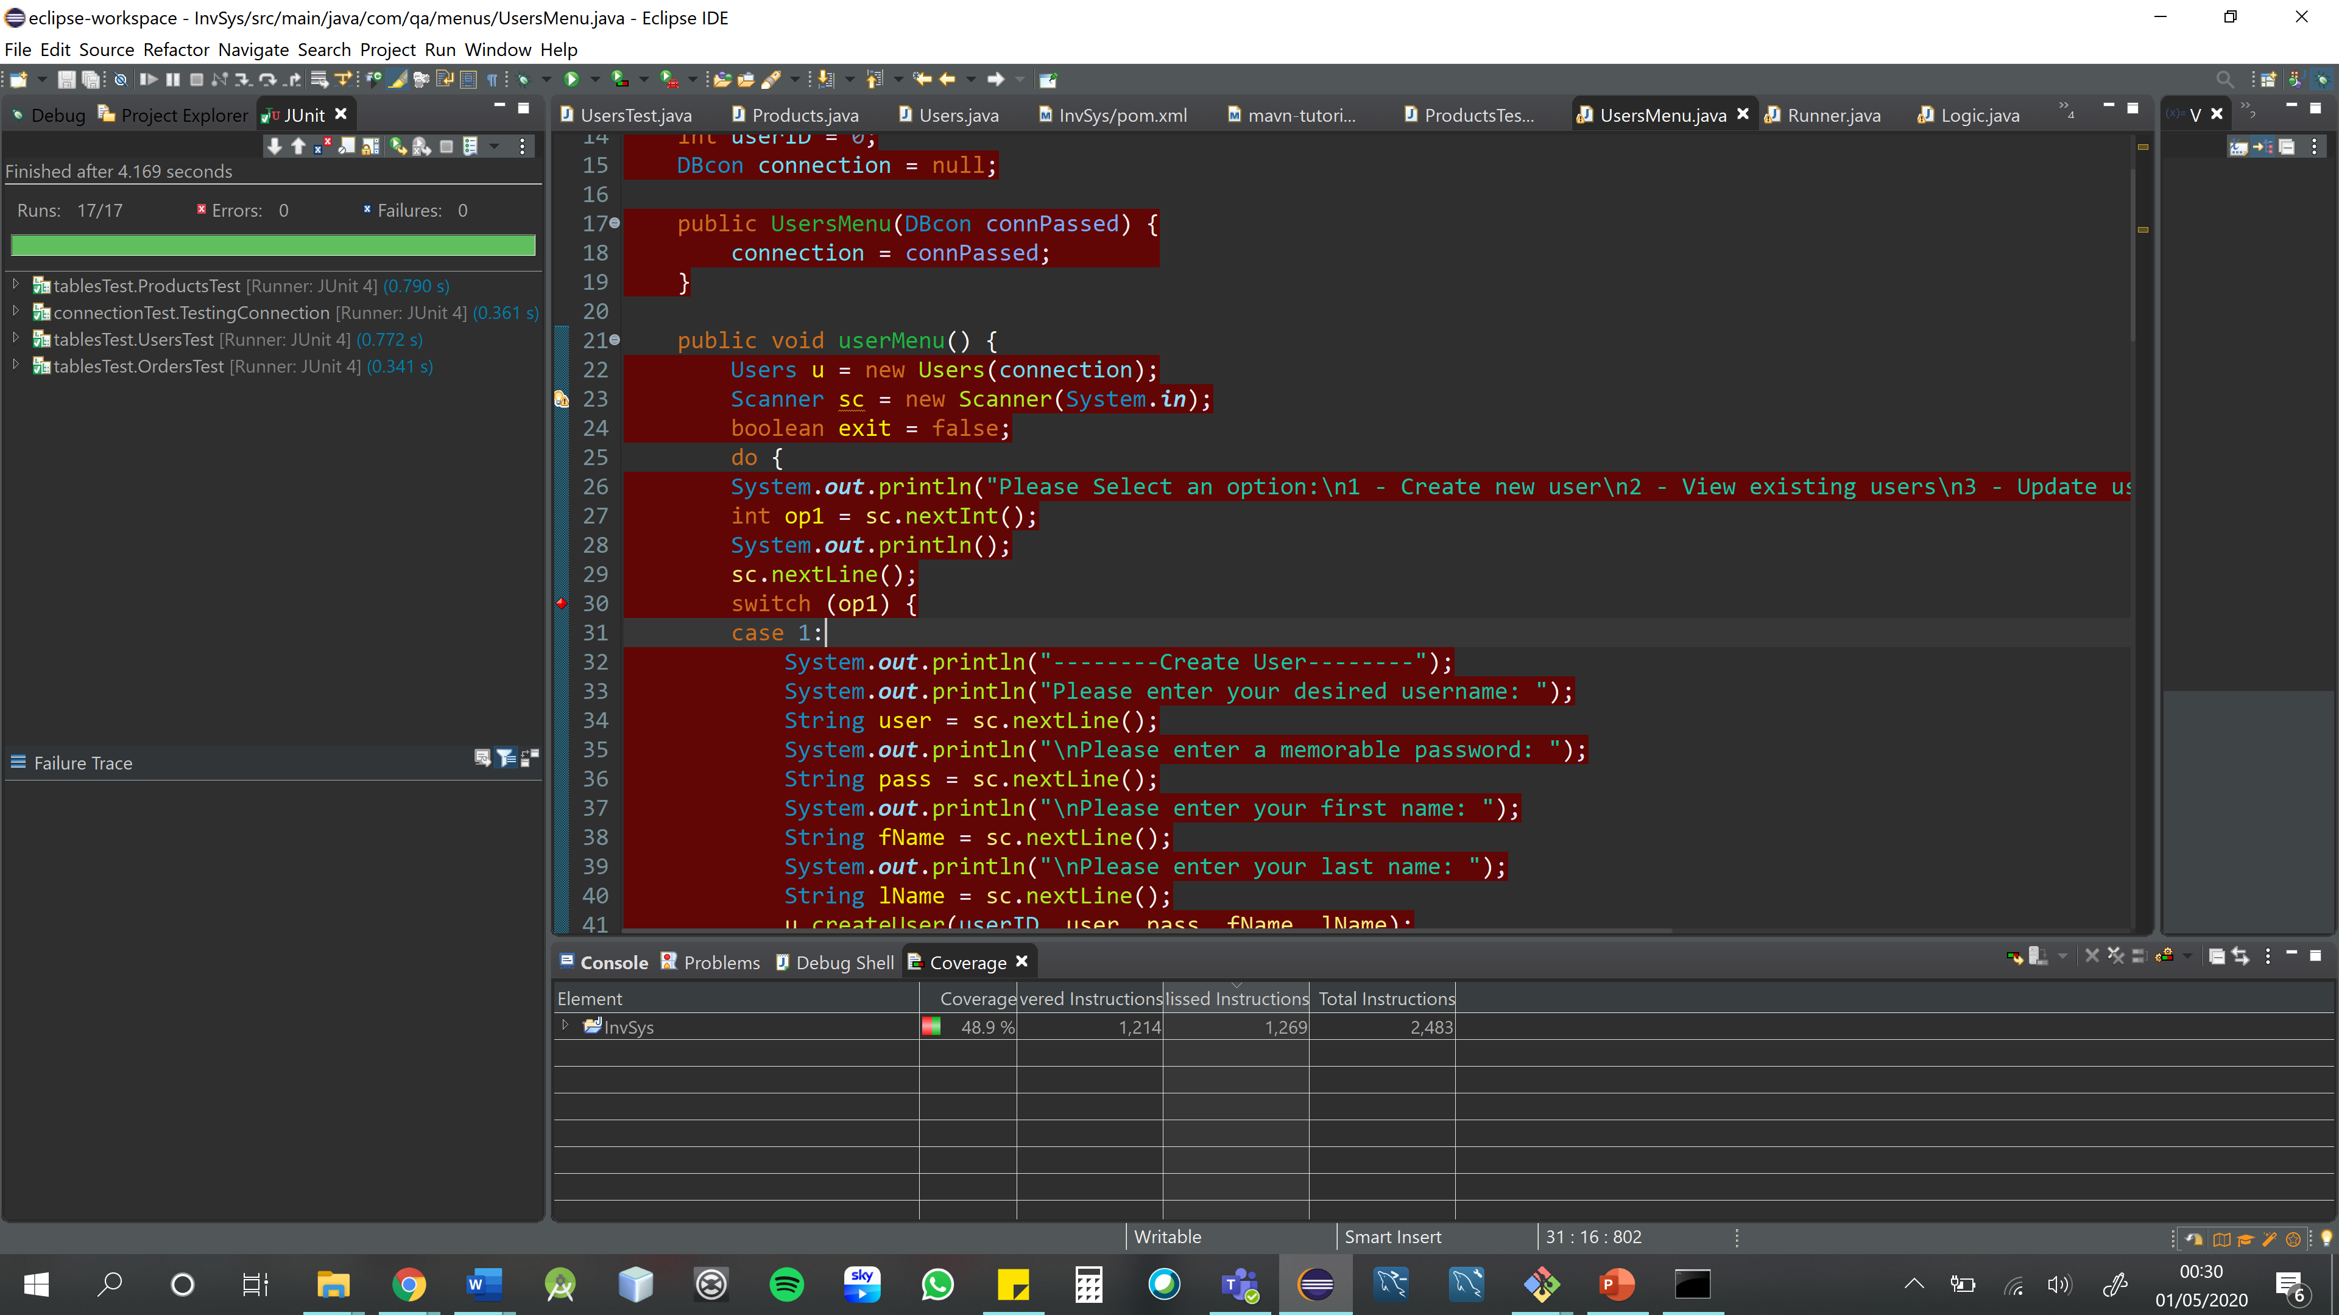
Testing

Slide 11
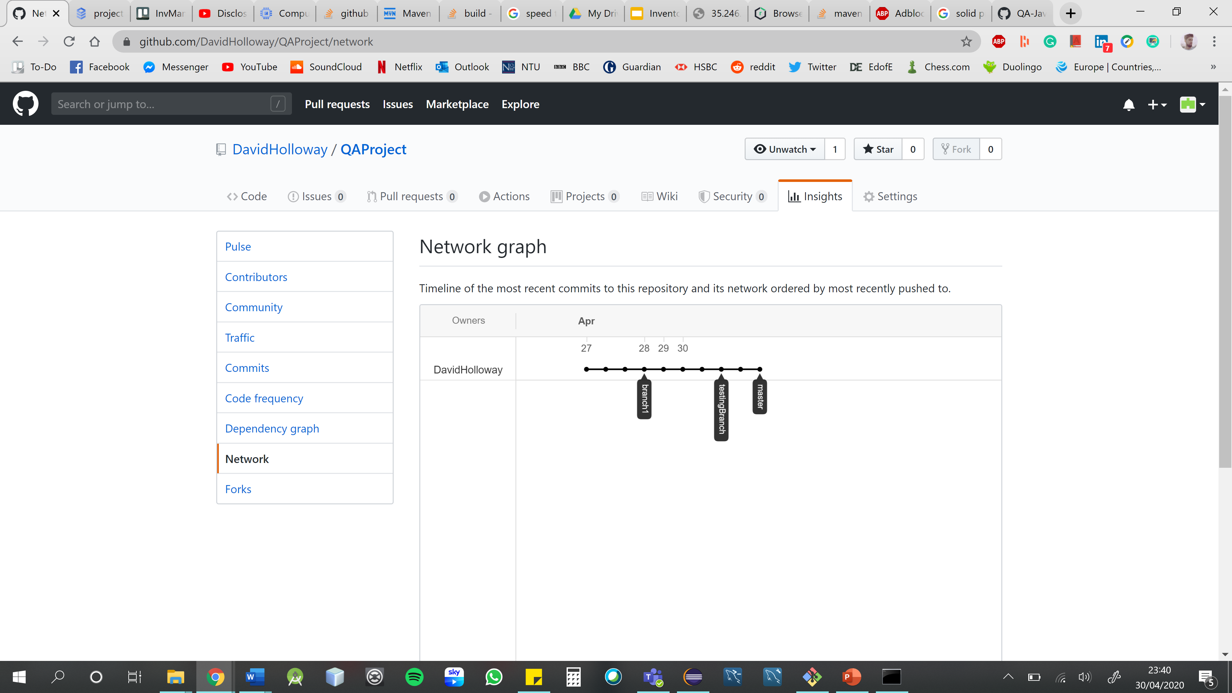
GitHub
GitHub was used as an external repository

Slide 12

Thank you!
Any Questions

